Slide 1
Withdrawal Process

Slide 2
Exit Process
A subscriber can exit from National Pension System (NPS) on following conditions
Upon attainment of the age of 60 years (Superannuation)
At any time before attaining the age of 60 years (Premature Exit)
Death of the subscriber

Slide 3
Superannuation
Subscriber can withdraw a lump sum amount up to 60% of total corpus
Remaining 40% needs to be used for buying an Annuity Scheme from Annuity Service Provider (ASP)
Subscriber can select any one of the available ASPs from whom he / she will get monthly pension

Slide 4
Premature Exit
Subscriber can withdraw a lump sum amount maximum up to 20% of total corpus
Remaining 80% has to be used for buying an Annuity Scheme from Annuity Service Provider (ASP)
Subscriber can select any one of the available ASPs from whom he / she will get monthly pension

Slide 5
Annuity Service Providers
Annuity Service Providers empanelled are

Slide 6
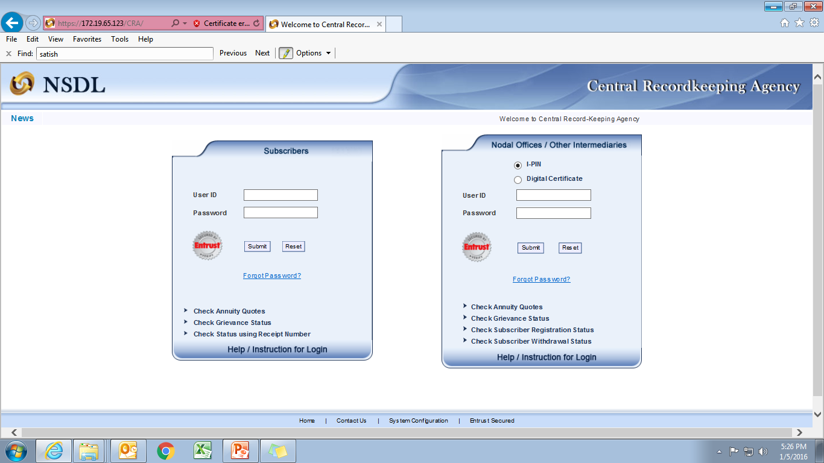
Annuity Quotes
To get the Annuity Quotes, click here

Slide 7
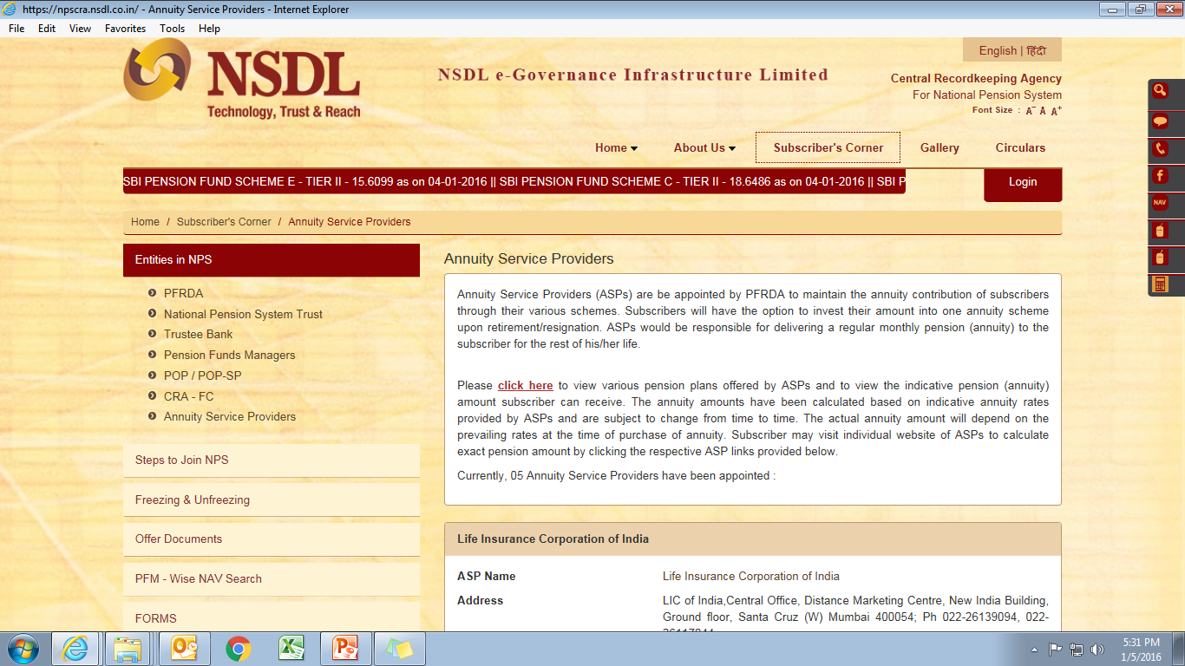

Slide 8
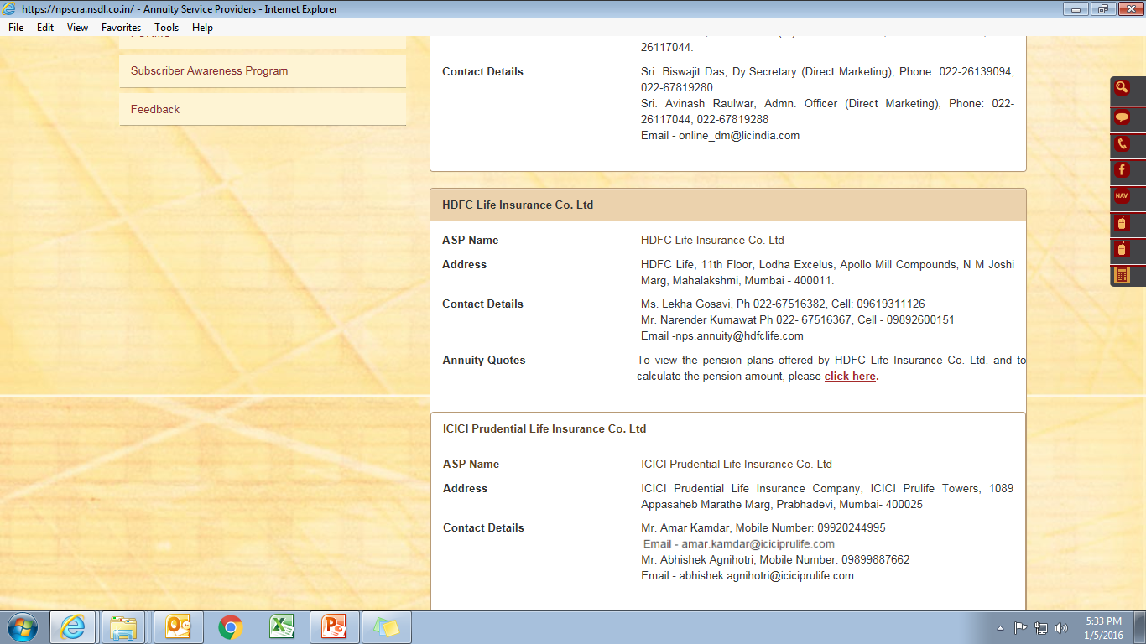

Slide 9
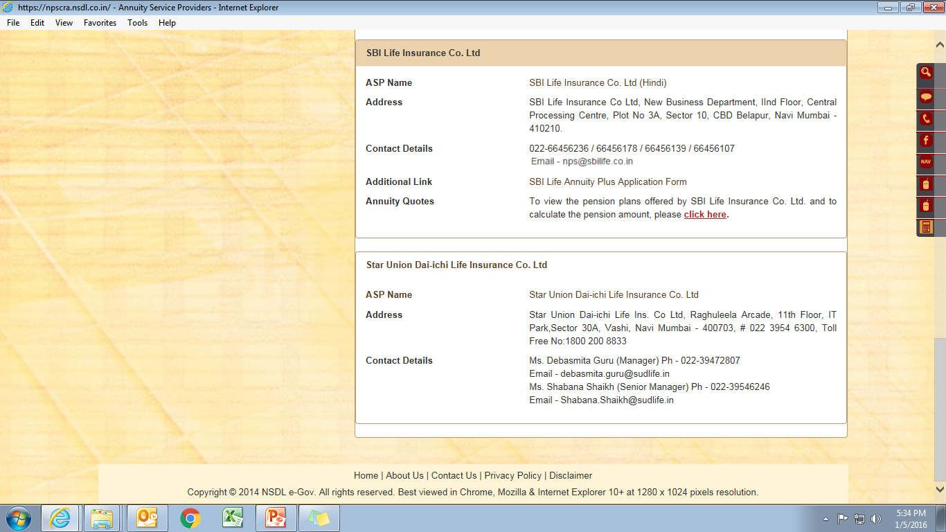
To view Annuity Quotes for various pension plans, “Click Here”

Slide 10
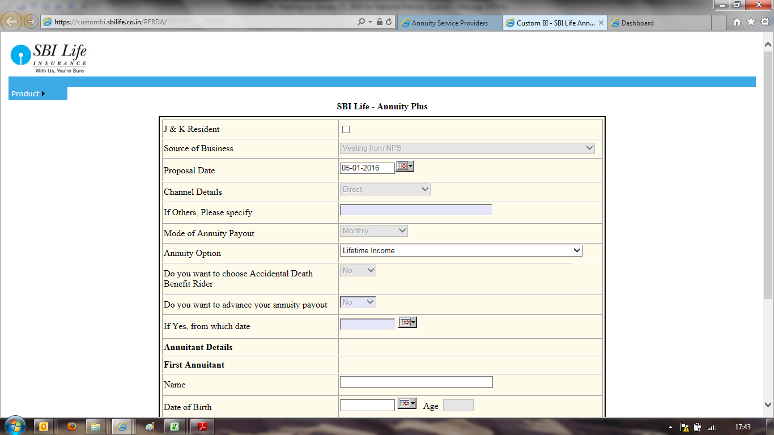
Enter necessary details to get the corresponding pension amount

Slide 11
This video demonstrates how Subscribers would capture a withdrawal request (Superannuation / Pre-Mature Exit) in CRA System to exit from NPS

Slide 12
To initiate withdrawal process, subscriber needs to go to
https://cra-nsdl.com/CRA/

Slide 13
Prerequisite
In order to initiate withdrawal process, subscriber need to use his “Claim ID”
In case of Superannuation, 6 months before subscriber’s retirement date, CRA intimates “Claim ID” to the subscriber through SMS, email and letter
In case of Premature Exit request, subscriber can generate Claim ID by visiting his Nodal Office or POP

Slide 14
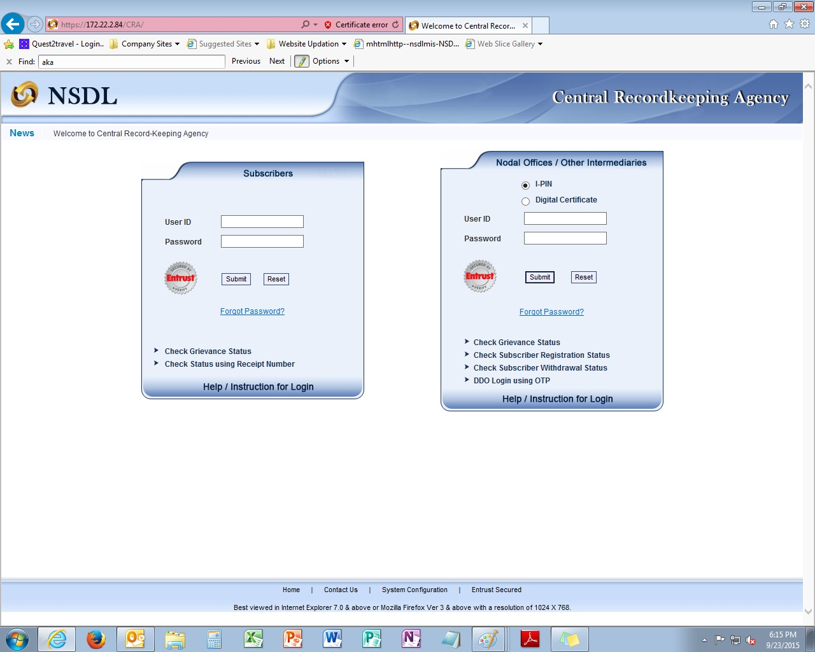
Enter your 12 digit Permanent Retirement Account Number (PRAN) as User ID & IPIN as your password

Slide 15
110051132967
**********

Slide 16
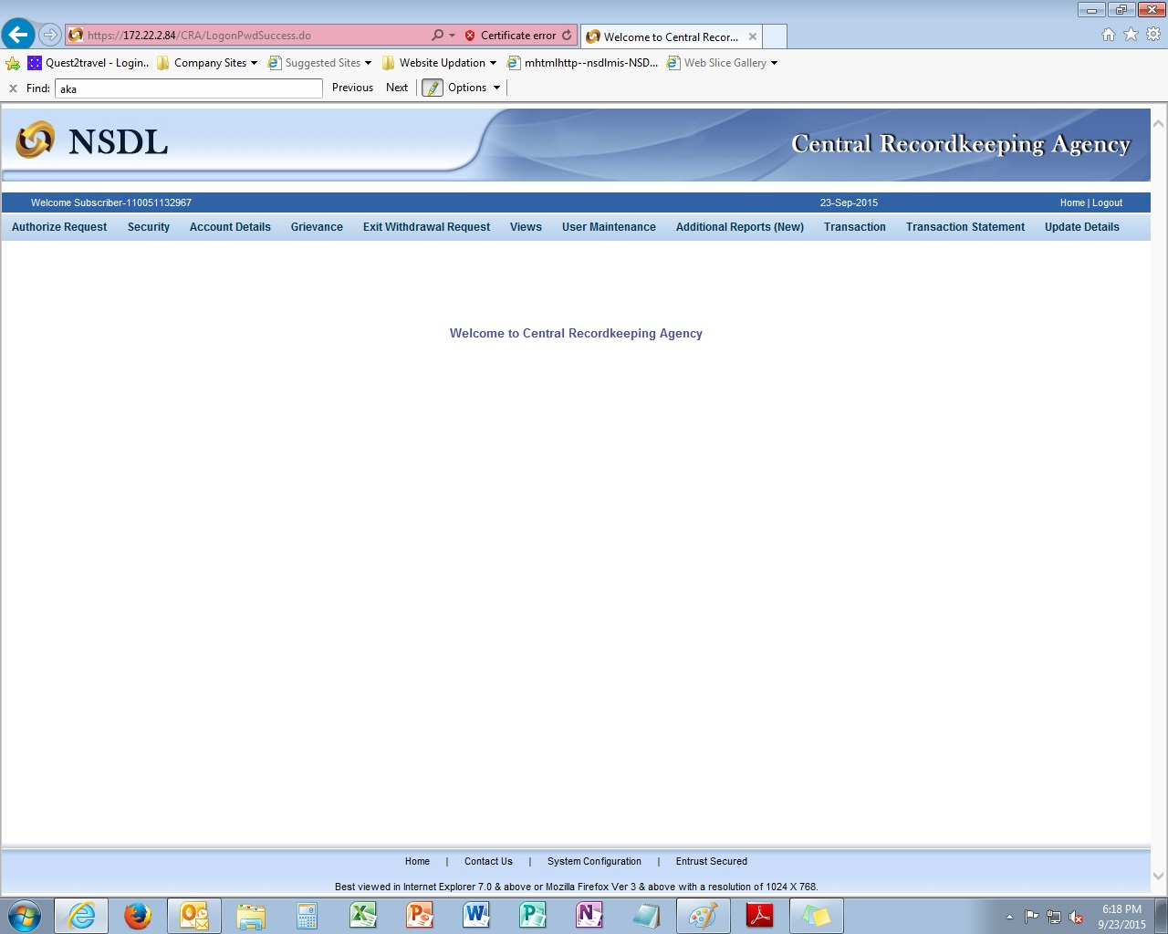
Click on “Exit Withdrawal Request”
Click “Initiate Withdrawal Request” to initiate your withdrawal request

Slide 18
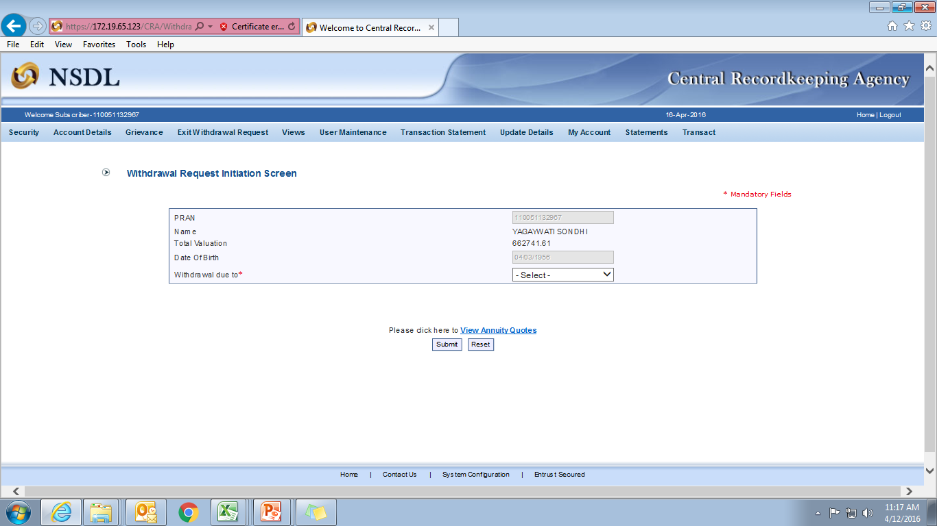
Select withdrawal option “Superannuation” or “Premature Exit”

Slide 19
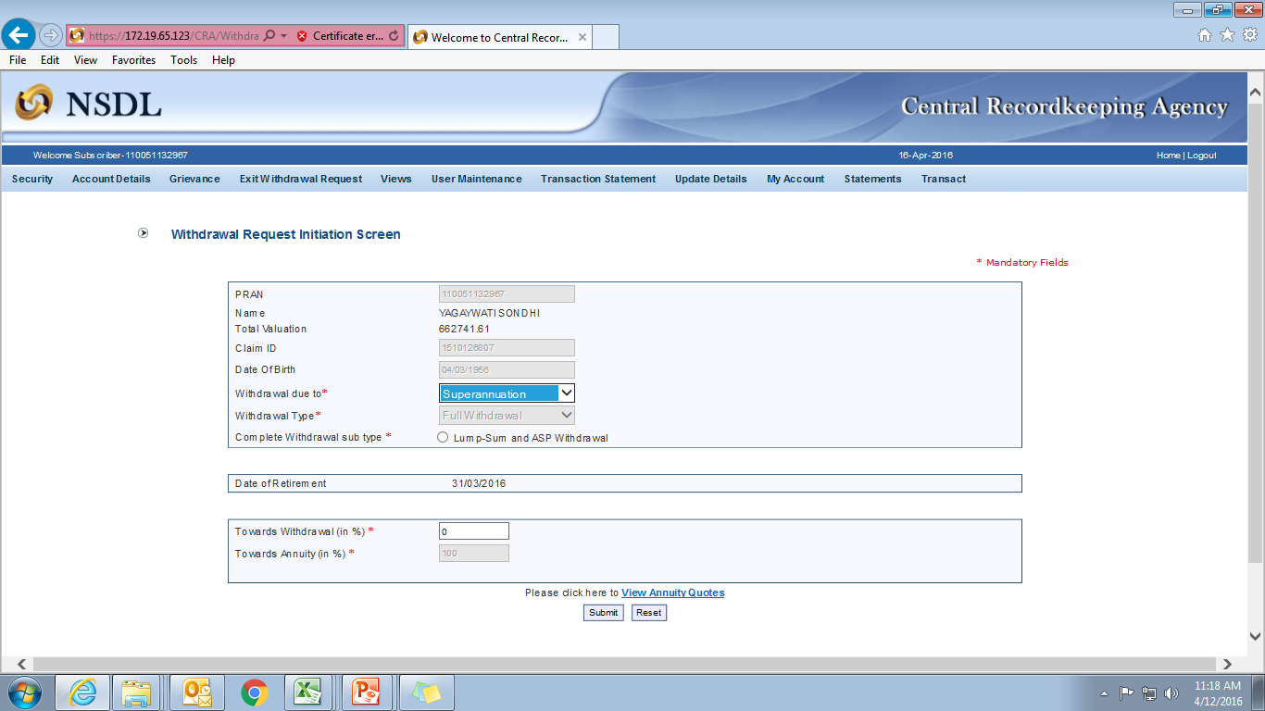
If the total corpus amount is below 2 lakhs at the time of retirement, subscriber can opt for 100% withdrawal
User needs to enter withdrawal percentage
60
40
100

Slide 20
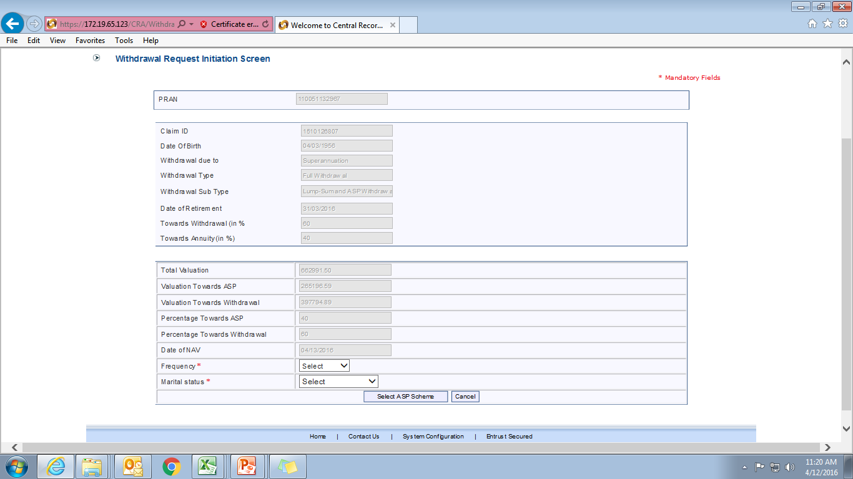
User needs to enter frequency. Kindly note for Govt. subscriber, frequency should be monthly only.

Slide 21
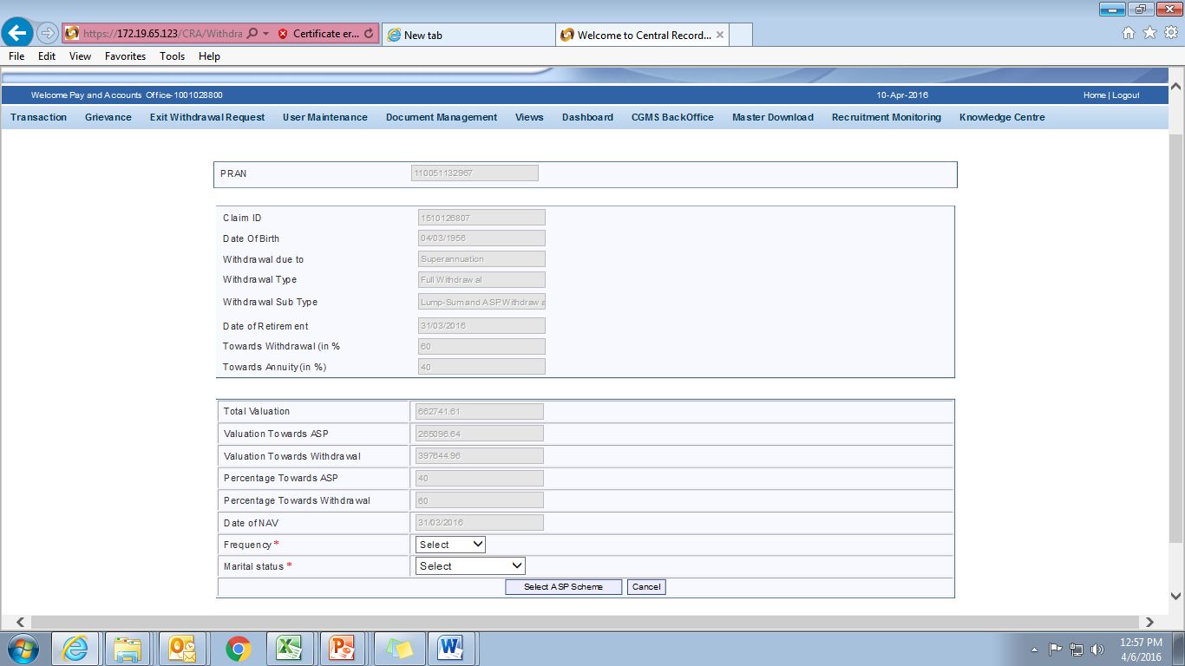
User needs to enter marital status

Slide 22
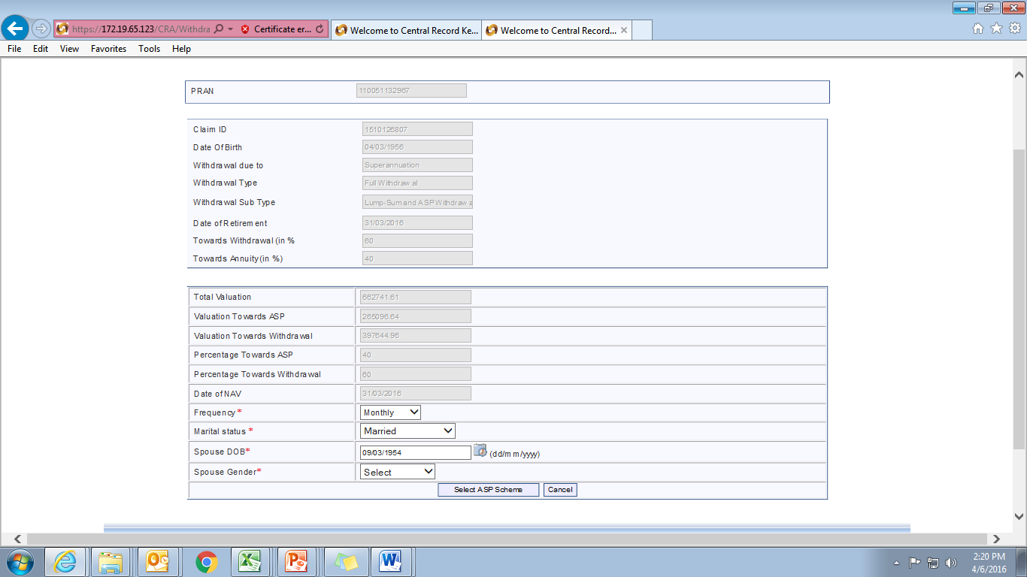
User needs to enter Spouse Date of Birth & Gender
Select ASP scheme

Slide 26
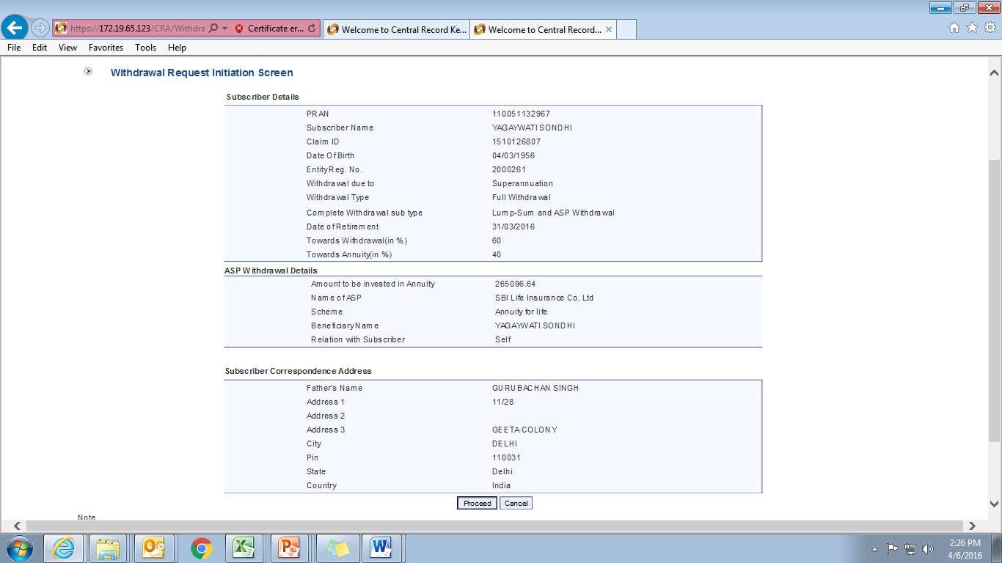
Verify the details entered by you and click “Proceed” to continue. In case user wish to edit any details, please click “Cancel”

Slide 27
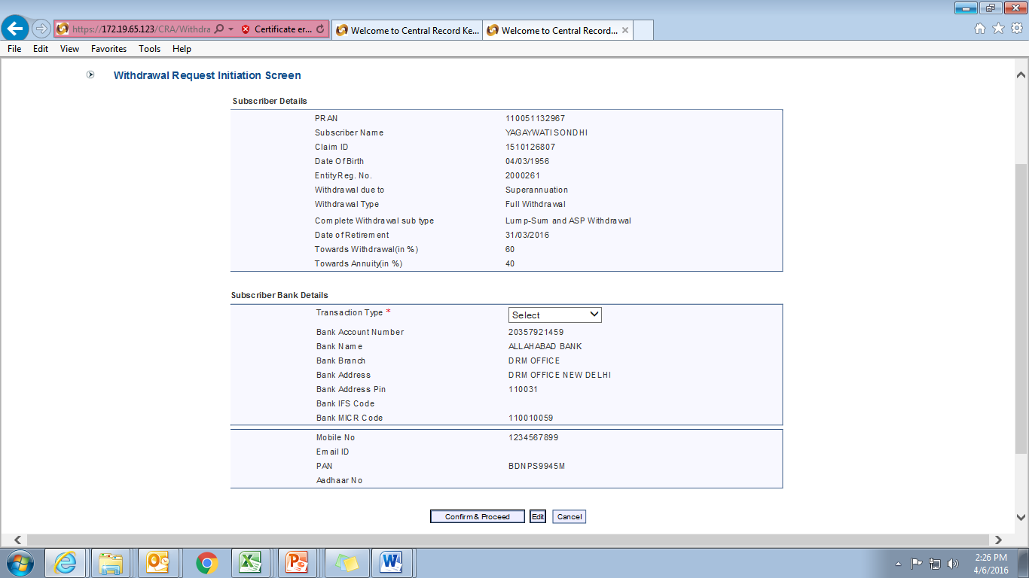
User need to select transaction type “Electronic”

Slide 28
Nodal Office has to enter last drawn salary bank account details of subscriber
Click “Edit” to change subscriber bank details if required. Subscriber withdrawal amount will be transferred to this bank account.

Slide 29
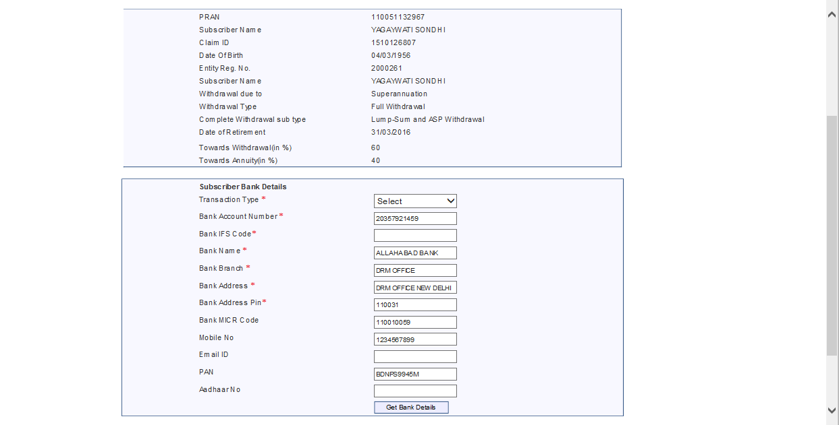
Please enter your bank IFS Code along with your email ID and PAN/Aadhaar number
ALLA0212162
sondhia@gmail.com

Slide 30
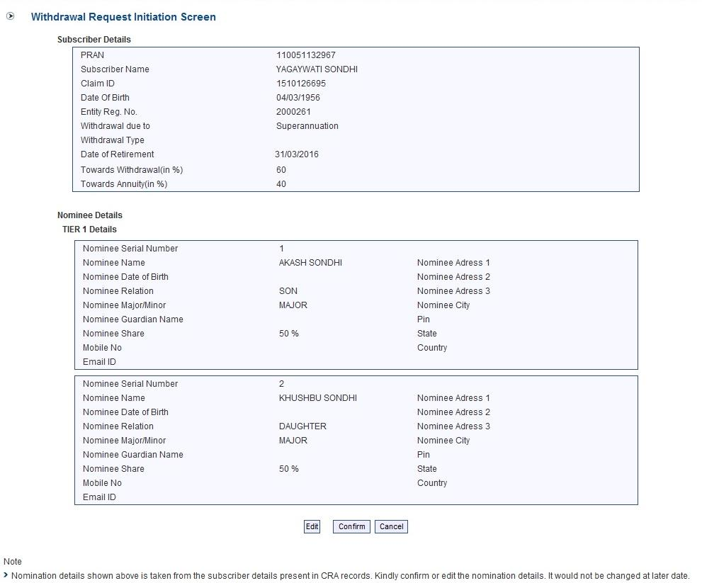
Click “Edit” button to enter/update subscriber nomination details

Slide 31
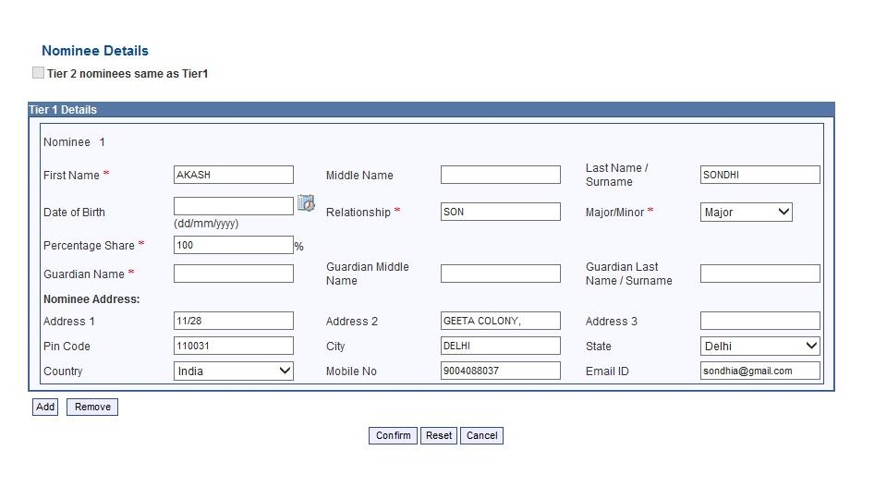
Enter nomination details such as Name, Relationship with nominee, Major/Minor, % Share and in case of minor, Guardian Name. Fields marked by * are mandatory
Click “Add” button if subscriber wants to add additional nominees. Maximum 3 nominees can be added.

Slide 32
Click confirm button to submit nomination details

Slide 33
User need to select these two documents

Slide 34
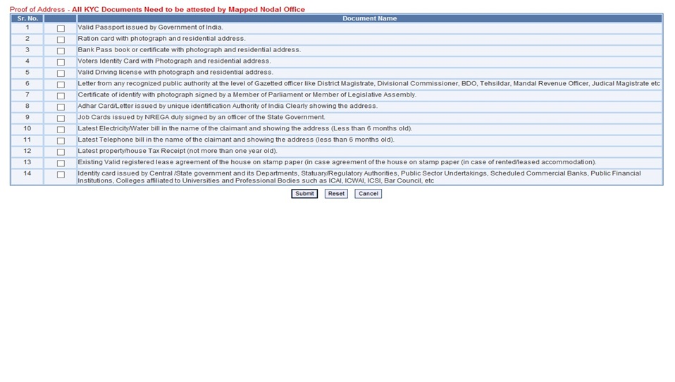
Subscriber will click on “submit” button to complete withdrawal request

Slide 35
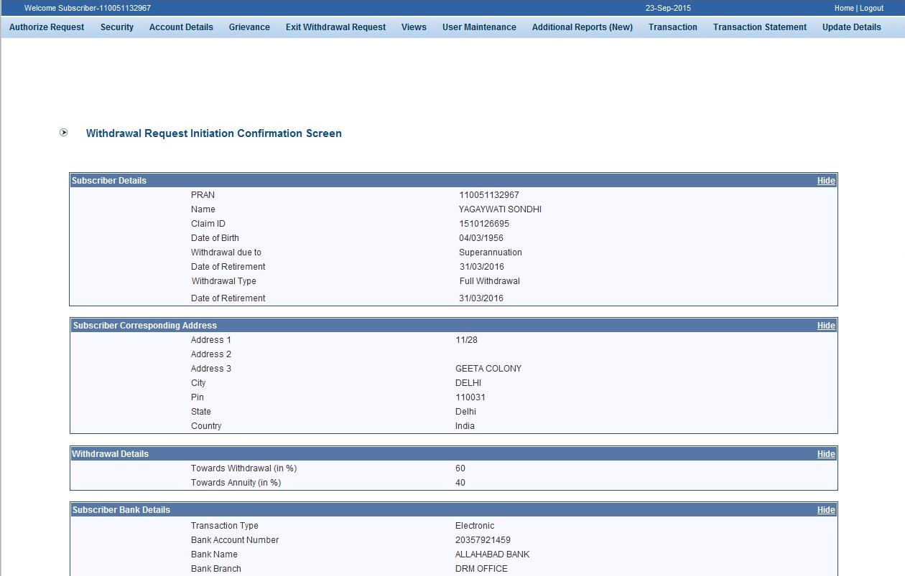
User to verify all the submitted details and then click on “Confirm” button

Slide 36
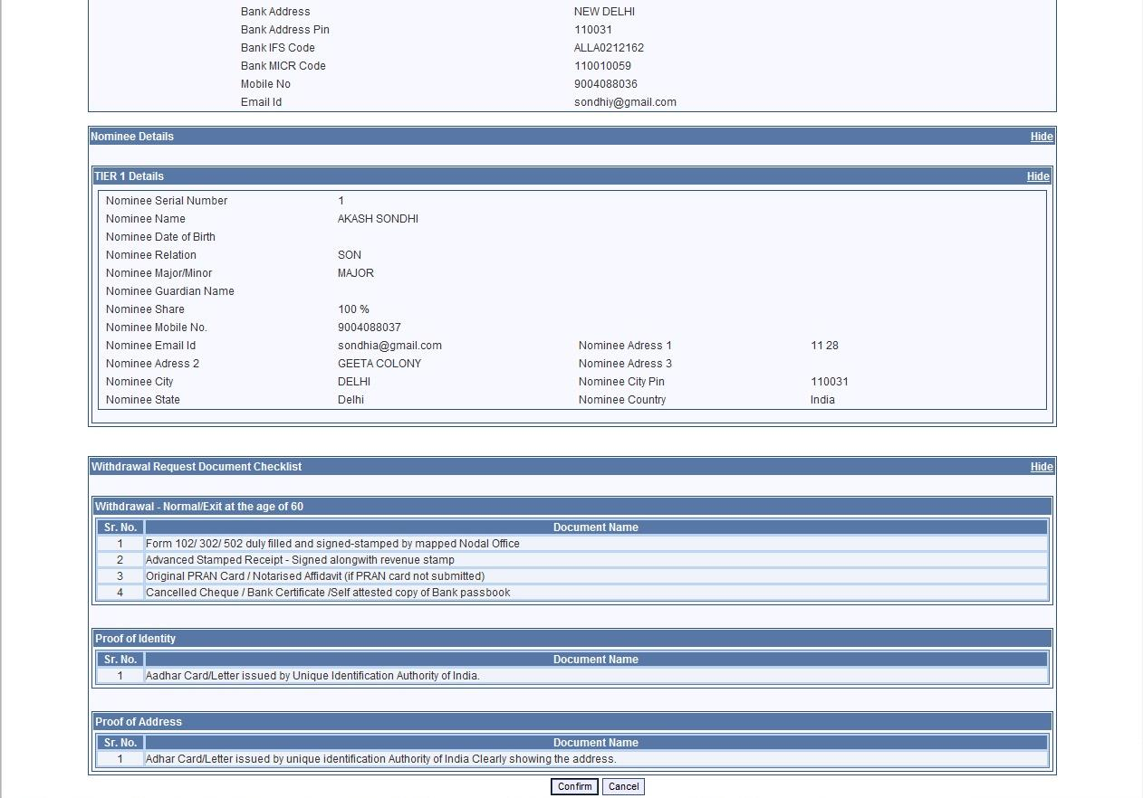
Click on “Confirm” button

Slide 37
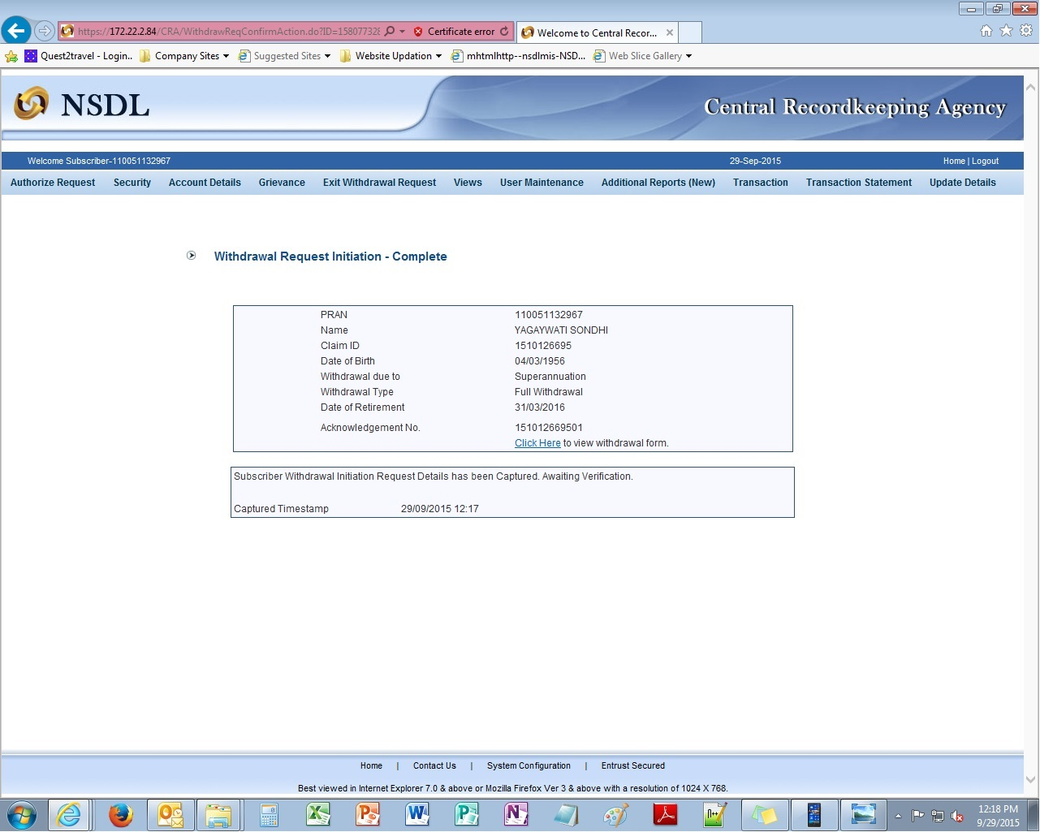
Once the withdrawal request is captured successfully, an Acknowledgement Number will be generated. You can view and print your withdrawal form by clicking on the highlighted link.

Slide 38
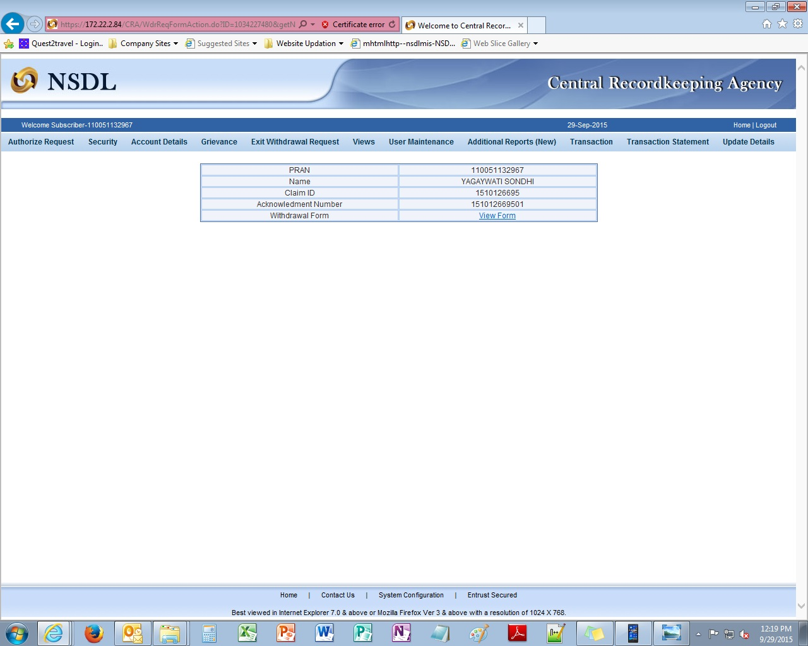

Slide 39
After successful Submission
Print the form, paste photograph & sign across photograph for self attestation and submit the Form to respective Nodal Office or POP-SP
Subscriber also need to submit all KYC documents
For Government subscribers, Nodal Office will submit Annexure I

Slide 40
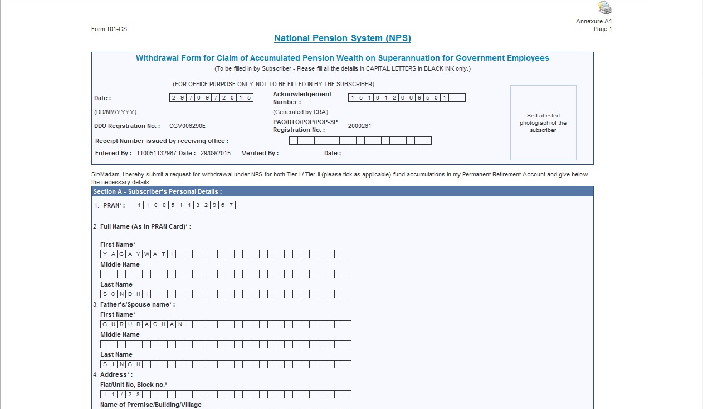
Subscriber needs to affix latest coloured photograph and sign across the photo for self attestation. Please ensure your signature matches with CRA records.

Slide 41
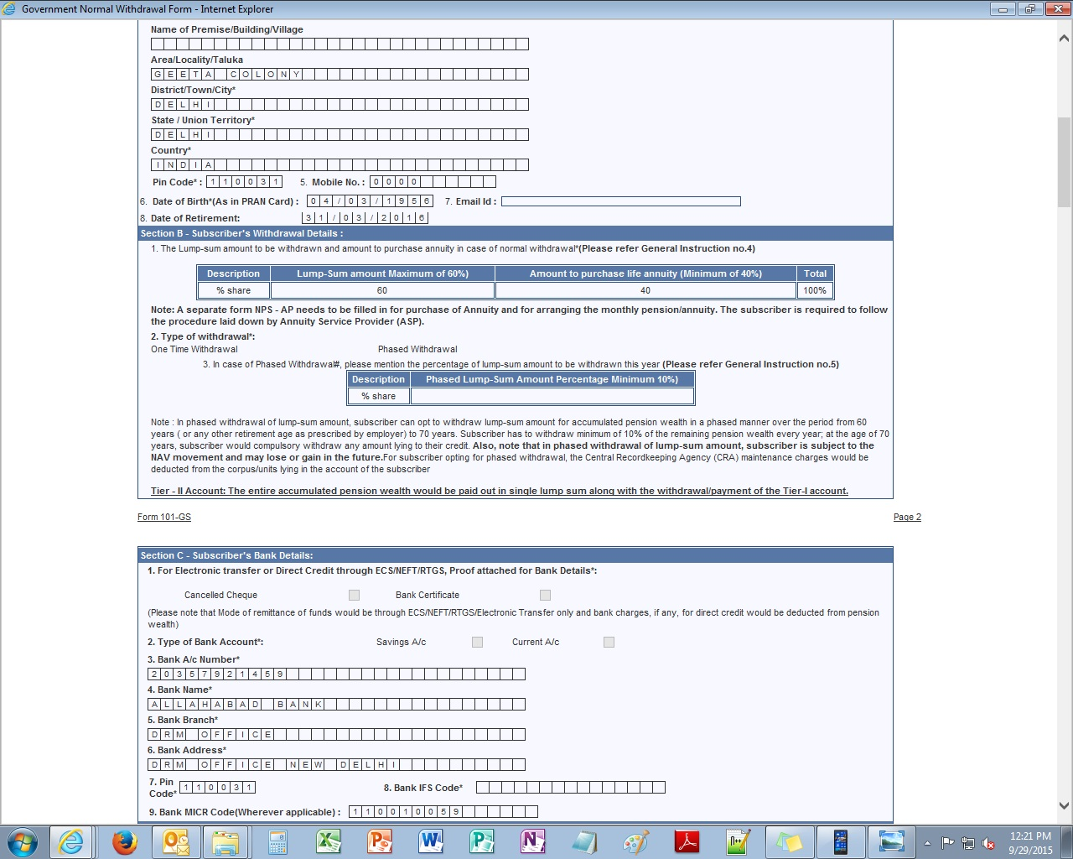

Slide 42
L I F E I N S U R A N C E C O R P O R A T I O N O F I N D I A
A S P 0 0 4
A N N U I T Y P A Y A B L E F O R L I F E W I T H 1 0 0 % A N N U I T Y P A Y A B L E T O S P O U S
E O N D E A T H O F A N N U I T A N T W I T H R E T U R N O N P U R C H A S E O F A N N U I T Y
A S 0 0 4 0 0 4
Subscriber has to sign within the Box. Please ensure your signature matches with CRA records.

Slide 43
1 1 / 2 8 G e e t a C o l o n y
D e l h i

Slide 44
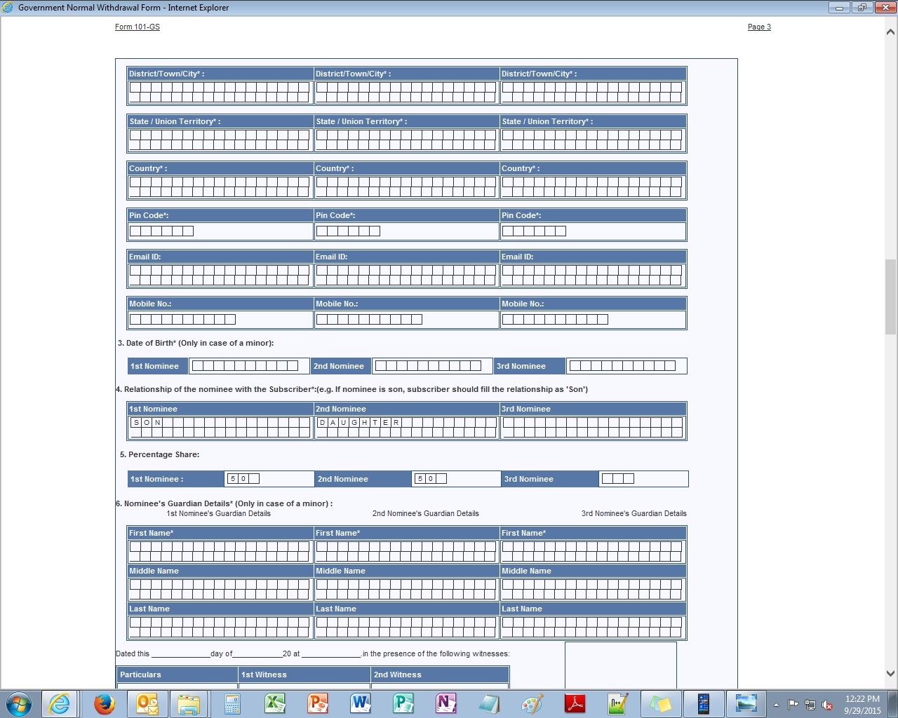
D e l h i
D e l h i
I n d i a
1 1 0 0 3 1

Slide 45
1 0 0

Slide 46
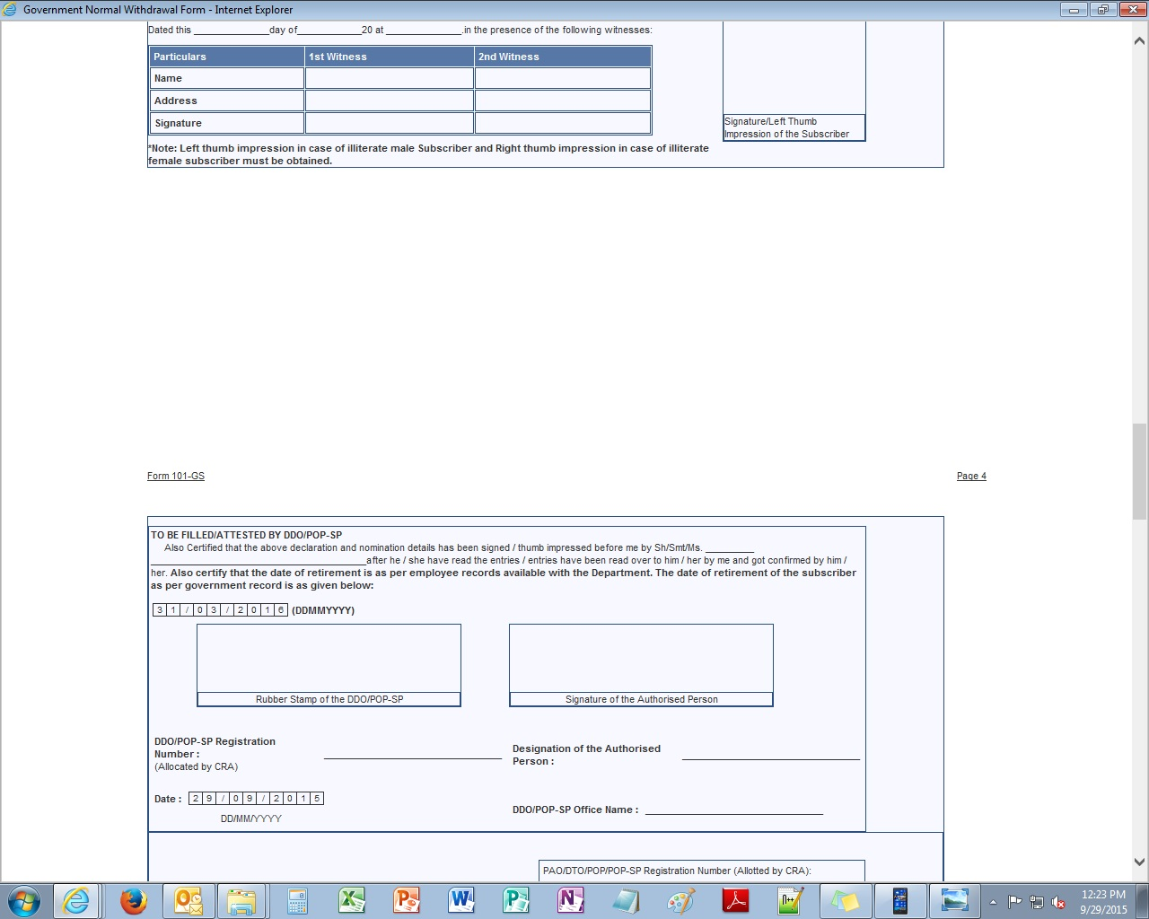
Dinesh Singh Dalvi
Ashwin Kumar Limaye
Geeta Colony, Delhi
Geeta Colony, Delhi
Witness details are mandatory. Please fill Name, Address and Signature of 2 witnesses.

Slide 47
Nodal Office/ POP-SP has to authorize the form along with the submitted KYC documents

Slide 48
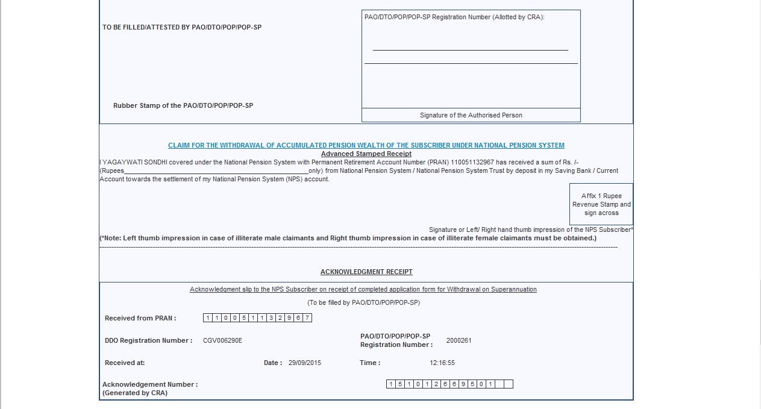
Please affix revenue stamp and sign across
Submit the form to your Nodal Office or POP-SP and collect the Acknowledgement

Slide 49
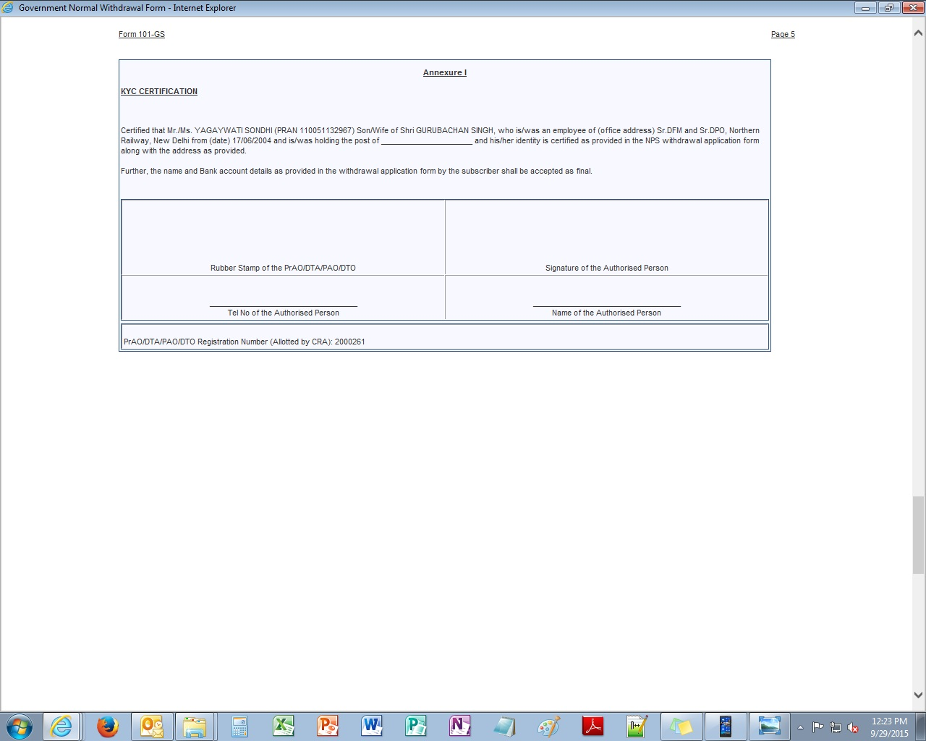
This section is for Govt. Office use only

Slide 50
Subscriber is required to submit physical withdrawal form along with required document to his/her Nodal Office/POP for processing of your withdrawal request

Slide 51
Thank you for viewing the demonstration.
In case of any assistance, please contact your Nodal Office / POP-SP

